Slide 1

Introduction to Convolutional Neural Network using MNIST Digit Recognition
Darryl See Wei Shen
Data Science and Artificial Intelligence
Nanyang Technological University

Slide 2
Scope
Agenda
What is Computer Vision?
What is MNIST Digits Dataset?
What is a Convolutional Neural Network?
Overview of building a model to recognize handwritten digits.
Coding a Convolutional Neural Network to recognize handwritten digits.
Discussion time.

Slide 3
Agenda
Have an idea of what computer vision is and how to build a Convolutional Neural Network for that purpse.

Slide 4

What is Computer Vision?
A subfield in Artificial Intelligence.
It is a technique that enables the computers to “see” and “recognize images like the human eye.

Slide 5
MNIST Digits Dataset
The de facto “hello world” dataset to Computer Vision.
Large database of handwritten digits that is commonly used in training various image processing systems.
The dataset consists of 60,000 small square 28x28 pixel grayscale images of handwritten single digits between 0 and 9.

Slide 6

What is a Convolutional Neural Network?
A type of neural network.
Images have high dimensionality, hence CNN is a perfect fit for a machine to learn from images.
Typically consists of a Convolutional Layer, an Activation Layer and a Pooling Layer.

Slide 7
Convolutional Layer
This is where learning happens.
Kernels (See next slide) are used to image features from the image.

Slide 8
Intuition behind Convolutional Layer
Kernels or Convolution Filters convolves through the image in a bid to learn and extract features from the image.
Imagine shinning a touch light on a wall in a dark room.
You can only see areas where the light shines on.
Similarly, the kernels only reads areas it convolves on and over.
It learns as it convolves.

Slide 9
Activation Layer
Activation function tells the network which neuron in the proceeding layer needs to be activated/deactivated.
Common activation functions are:
Rectified Linear Unit (relu)
Sigmoid
Softmax
Hyperbolic Tangent (tanh)

Slide 10
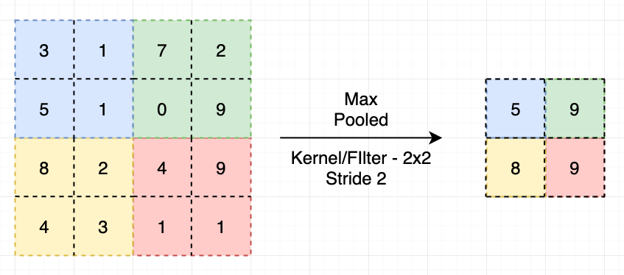
Pooling Layer
This layer extracts the important features.
There are a few pooling algorithms but the most commonly used on is Max Pooling.
Max Pooling extracts the most important feature from the feature map.

Slide 11
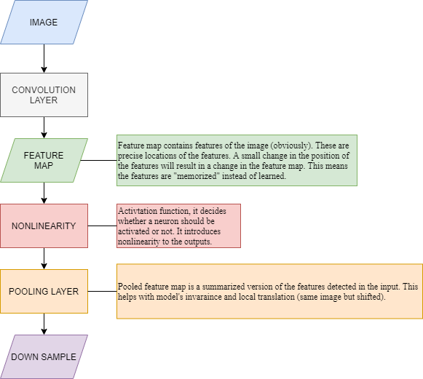
Overview of processes

Slide 12
Coding time!
Just code.

Slide 13
Discussions (Q&A)

